Slide 1
BASIC JAVASCRIPT FUNCTIONALITIES

Slide 2
Introduction
JavaScript created by Brendan Eich in 1995
Initially developed for Netscape Navigator
ECMAScript standard to ensure compatibility among different browsers
It is widely used for building dynamic and interactive websites.
JavaScript is a powerful programming language that can add interactivity to a website
Keywords: Netscape, ECMA

Slide 3
Introduction Cont…
JavaScript is a high-level, interpreted programming language
Used for form validation, dynamic content updates, and asynchronous communication
Frameworks like React, Angular, and Vue.js use JavaScript for building robust web applications
Keywords: interpreted language – compiled language, content updates

Slide 4
Variables and Data Types
Variables are containers for storing data values
They are used to label and store information that can be referenced and manipulated by the program
JavaScript has several fundamental data types:
Numbers: Used for numeric values (e.g., 5, 3.14).
Strings: Used for textual data (e.g., "Hello, World!").
Booleans: Used for true/false values.
Null: Represents the intentional absence of any object value.
Undefined: Denotes a variable that has been declared but not assigned a value.
Objects: A complex data type that can store key-value pairs

Slide 5
Variables and Data Types Cont…
Declaring Variables:
Use the var, let, or const keywords to declare variables.
var (old way): Function-scoped, can be re-declared.
let: Block-scoped, allows reassignment.
const: Block-scoped, cannot be reassigned
JavaScript is dynamically typed, meaning variable types can change during runtime.
Example: let myVar = 42; (numeric type), then later myVar = "Hello"; (string type).

Slide 6
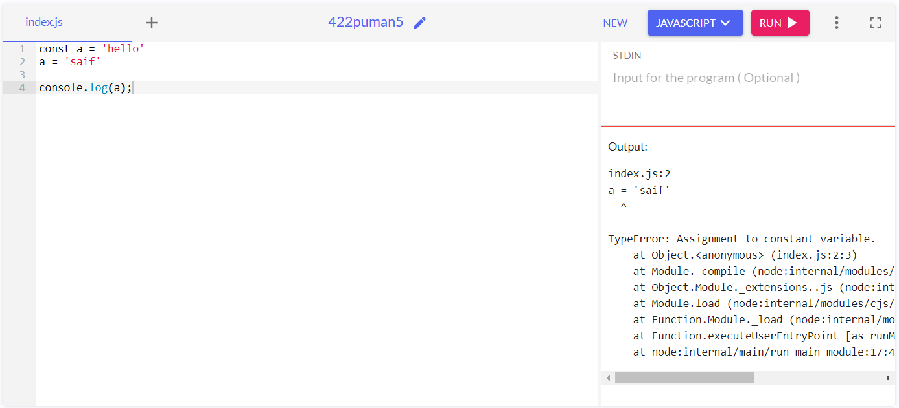
Usage of let, var, and const
let & const keywords were introduced in ES6 (2015).var existed since Javascript's inception
Const Identifiers declared with const cannot be re-assigned Ex: const name = "Hassan“ name = ‘Saif’ //Throws an error – Assignment to a constant variable

Slide 7
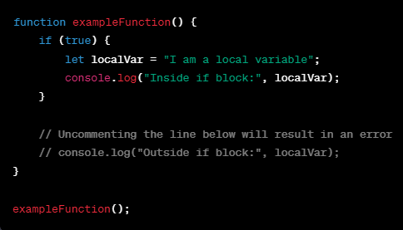
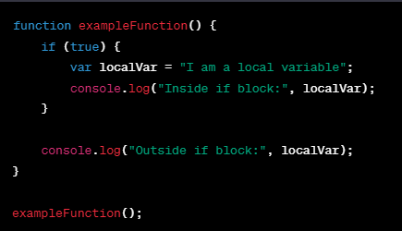
Usage of let, var, and const Cont…
let & var – Pretty similar the main difference separating these two apart lies in two concepts Scoping and Hoisting
scoping:
Variables declared by var are scoped to the immediate function body while let variables are scoped to the immediate enclosing block.

Slide 8
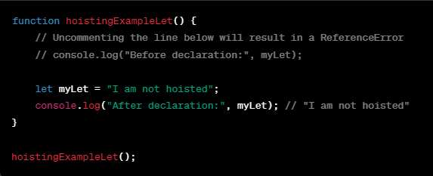
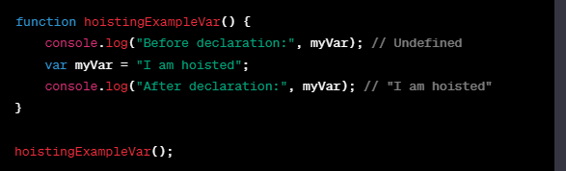
Usage of let, var, and const Cont…
Hoisting
Hoisting is a JavaScript behavior where variable and function declarations are moved to the top of their containing scope during the compilation phase before the code is executed
Use let when you know that the value of an identifier will change.
Use const when the identifier value is constant and won’t change.
Avoid using var because it causes confusion & bugs

Slide 9
Operators and Expressions
Operators perform operations on variables and values.
Arithmetic operators: +, -, *, /, %.
Comparison operators: ==, ===, !=, !==, <, >, <=, >=.
Logical operators: &&, ||, !.
Strict Check: Compares the values between two variables along with their data types

Slide 10
Functions
Functions are blocks of reusable code.
Define a function using the function keyword.
Functions can take parameters.
Parameters are placeholders for values passed to a function.
Functions can return values using the return keyword.
Example: function add(a, b) { return a + b; }

Slide 11
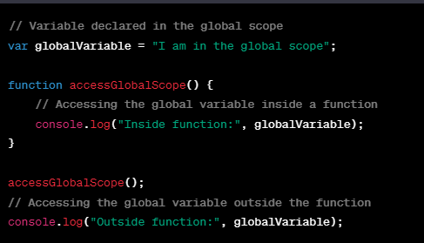
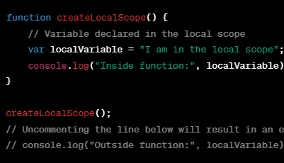
Scope and Types
Definition:
Scope refers to the region or context in your code where a variable is declared and can be accessed.
Global Scope:
Variables declared outside any function have a global scope.
They can be accessed from anywhere in the code Local Scope:
Variables declared inside a function have local scope.
They are only accessible within that function.

Slide 12
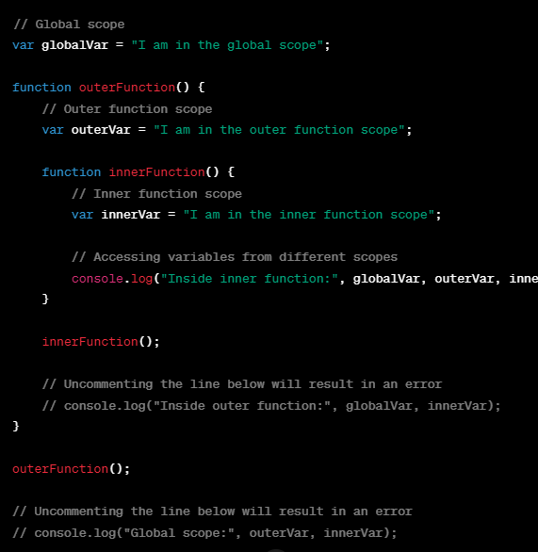
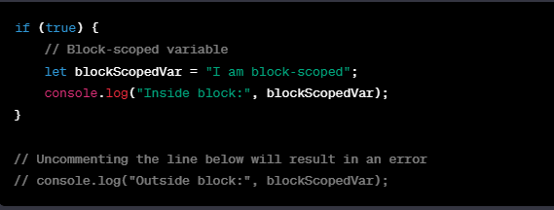
Scopes and types Cont…
Block Scope:
Introduced by let and const. Variables declared using let and const have a block-level scope, meaning they are limited to the block (inside curly braces) where they are defined. Scope Chain:
JavaScript follows a scope chain to find the value of a variable. If a variable is not found in the local scope, JavaScript looks for it in the outer scope, continuing until it reaches the global scope

Slide 13
Closure
Definition:
A closure is created when a function is defined inside another function, allowing the inner function to access variables from the outer (enclosing) function.
Creating Closures:
Closures are created when an inner function is returned or passed as an argument.
The inner function "closes over" the variables it references, preserving their values.
Accessing Outer Variables:
Closures have access to the variables in their outer (enclosing) scope, even after the outer function has finished executing.

Slide 14
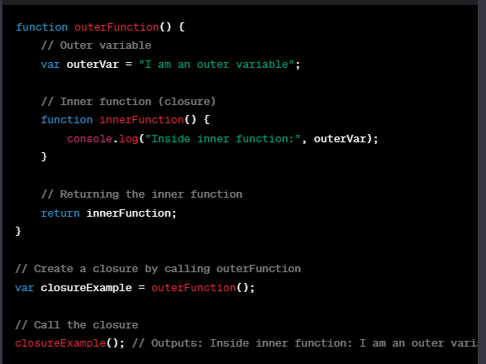
Closure Cont…
Use Cases:
Closures are often used for data encapsulation and private variables.
They allow functions to "remember" and access the environment in which they were created.
Memory Management:
Closures can lead to long-lived references, potentially causing memory issues.
Be mindful of creating unnecessary closures to avoid memory leaks.

Slide 15

Arrays
Definition:
An array is a data structure that stores a collection of elements, each identified by an index or a key.
Declaration and Initialization:
Declare an array using square brackets: var myArray = [];
Initialize with values: var numbers = [1, 2, 3, 4, 5];
Accessing Elements:
Elements in an array are accessed by their index.
Indexing starts from 0: var firstElement = numbers[0];
Time Complexity – O(n)
Array Properties:
length: Returns the number of elements in the array.

Slide 16
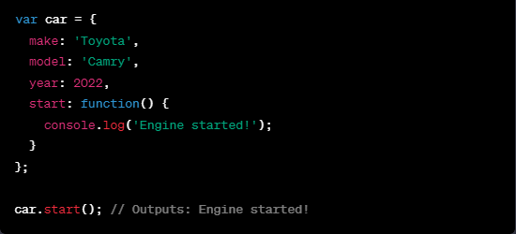
Objects
Definition:
An object is a collection of key-value pairs, where each key is a string, and each value can be of any data type.
Declaration and Initialization:
Declare an object using curly braces: var myObject = {};
var person = { name: 'John', age: 25, city: 'New York’ };
Accessing Properties:
Properties in an object are accessed using dot notation or bracket notation.
var personName = person.name; or var personName = person['name’];
Adding and Deleting Properties:
Add a new property: person.job = 'Engineer';
Delete a property: delete person.age;

Slide 17
JS Events
Definition: Events are actions or occurrences that happen in the browser, often initiated by users or the browser itself.
Importance: JavaScript events enable interactivity and dynamic behavior on web pages.
Events are often associated with HTML attributes.
JavaScript Event Listeners:
Event listeners are functions that wait for a specific event to occur on an element. Allow for cleaner separation of HTML and JavaScript code.

Slide 18


Event Cont…
The onClick event is triggered when an element is clicked.
Use the onClick attribute to associate a JavaScript function with the click event of an element. Example:
Declarative way –
Imperative way –

Slide 19
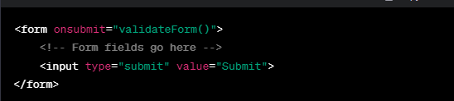
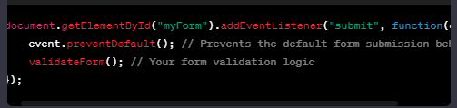
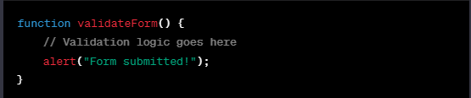
Event Cont…
The onSubmit event is triggered when a form is submitted, typically by clicking a submit button.
Use the onSubmit attribute to associate a JavaScript function with the submission of a form.
Example
Imperative way –
Declarative way -

Slide 20

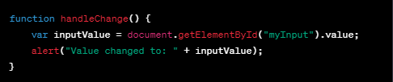
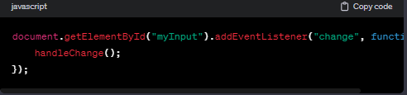
Event Cont…
The onChange event is triggered when the value of an input, select, or text-area element changes.
Use the onChange attribute to associate a JavaScript function with the change event of an element.
Example

Slide 21
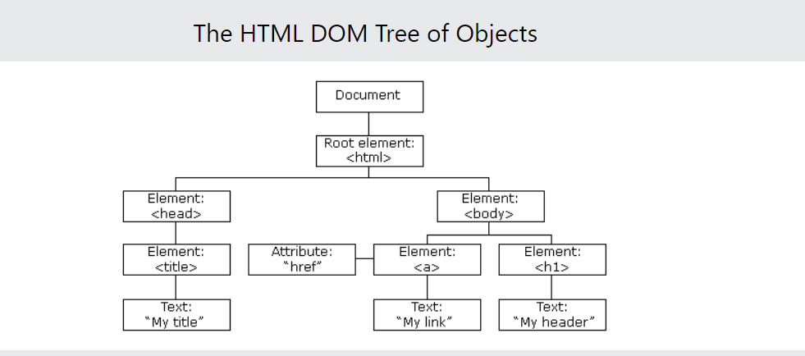
DOM Model
When a web page is loaded, the browser creates a Document Object Model of the page. With the object model, JavaScript gets all the power it needs to create dynamic HTML:
JavaScript can change all the HTML elements on the page
JavaScript can change all the HTML attributes on the page
JavaScript can change all the CSS styles on the page
JavaScript can remove existing HTML elements and attributes
JavaScript can add new HTML elements and attributes
JavaScript can react to all existing HTML events on the page
JavaScript can create new HTML events on the page

Slide 22

DOM Methods
HTML DOM methods are actions you can perform (on HTML Elements). The HTML DOM can be accessed with JavaScript (and with other programming languages).
In the DOM, all HTML elements are defined as objects.
The programming interface is the properties and methods of each object.
A property is a value that you can get or set (like changing the content of an HTML element).
A method is an action you can do (like adding or deleting an HTML element).

Slide 23
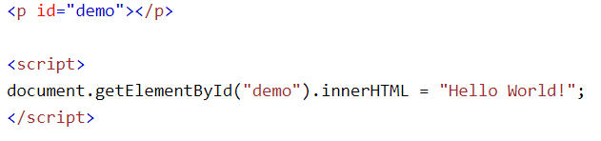
DOM Methods Cont…
The most common way to access an HTML element is to use the id of the element.
In the example above the getElementById method used id="demo" to find the element.
The easiest way to get the content of an element is by using the innerHTML property.
The innerHTML property is useful for getting or replacing the content of HTML elements.

Slide 24
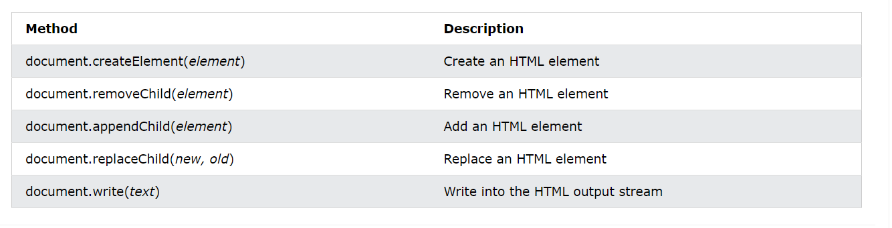
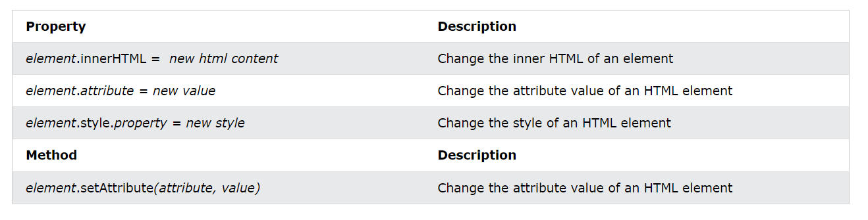
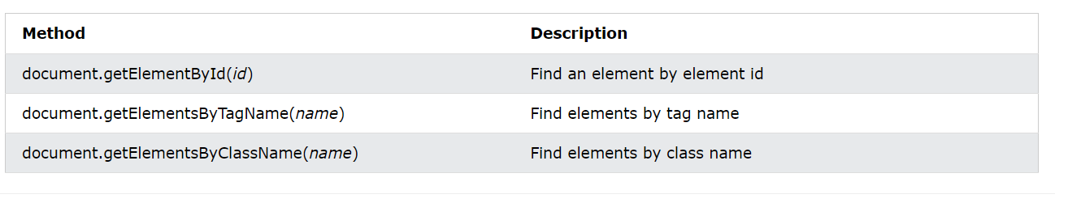
DOM Document

Slide 25
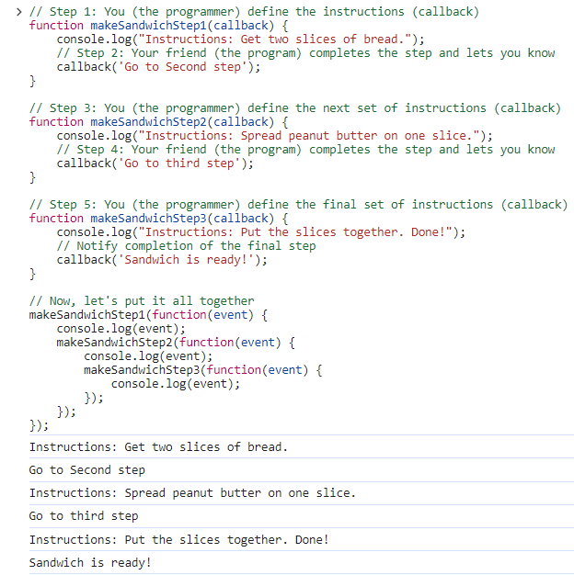
Callback
Definition: When you attach a function to an event like onClick, you are saying, "Call this function back when the associated event happens” Analogy: You're teaching a friend how to make a sandwich, and you want them to let you know when they finish each step so you can guide them through the next one. In this scenario:
You (the programmer): You provide the overall instructions and wait for your friend to finish each step.
Your friend (the program): After completing each step, your friend lets you know, and you provide the next set of instructions.
In programming, this interaction is like using callbacks.

Slide 26
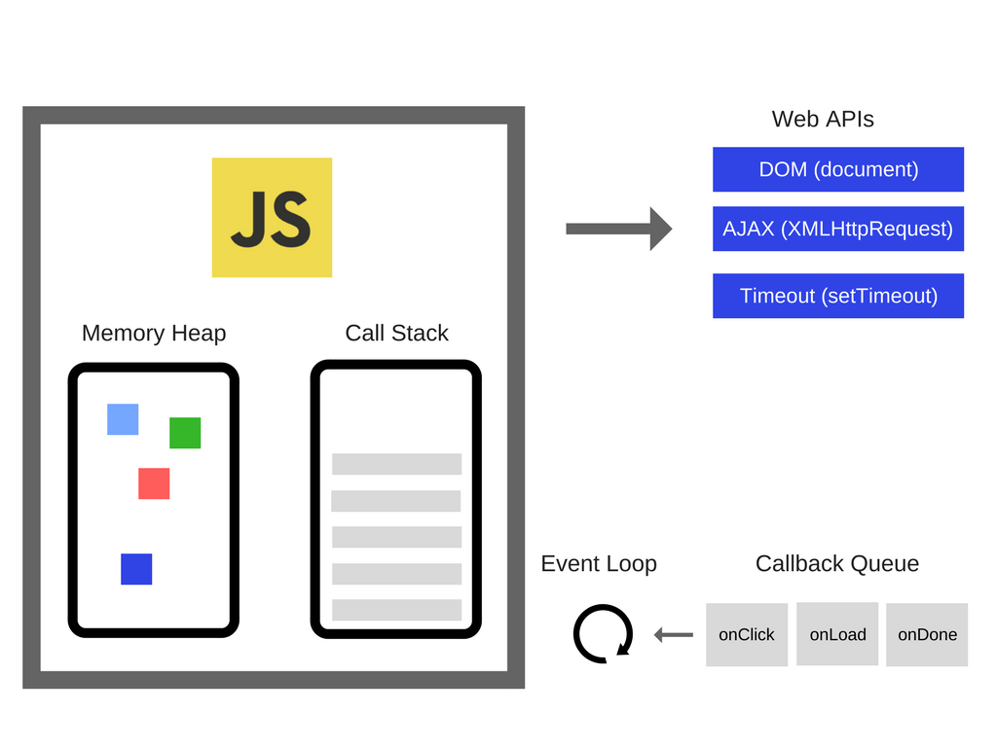
How JS Works
A single-threaded language
JS has a call stack, event loops, and callback queue, API-related info and heap
Chrome browser uses the V8 for its runtime execution
Check this link - https://www.youtube.com/watch?v=8aGhZQkoFbQ

Slide 27
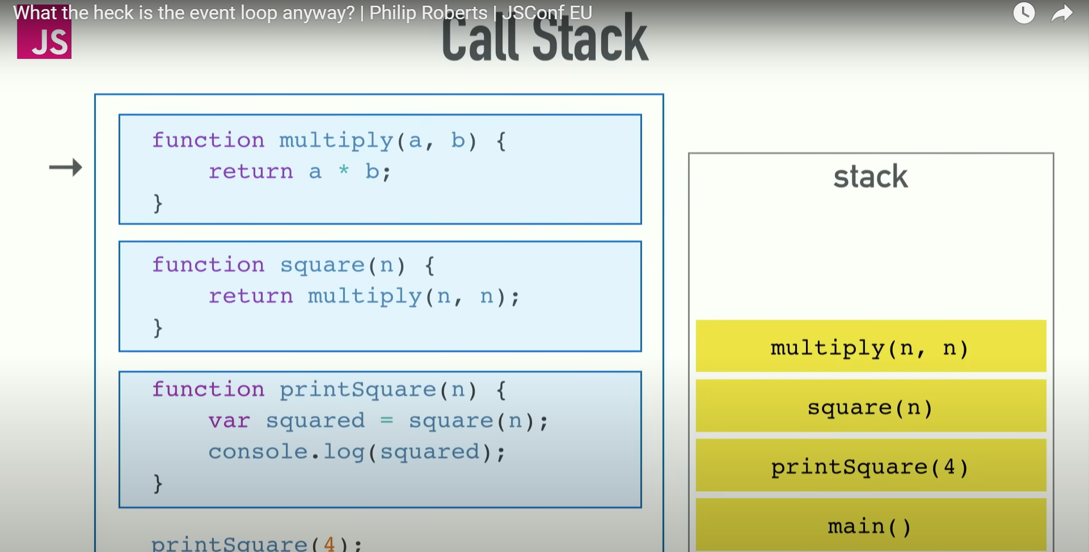
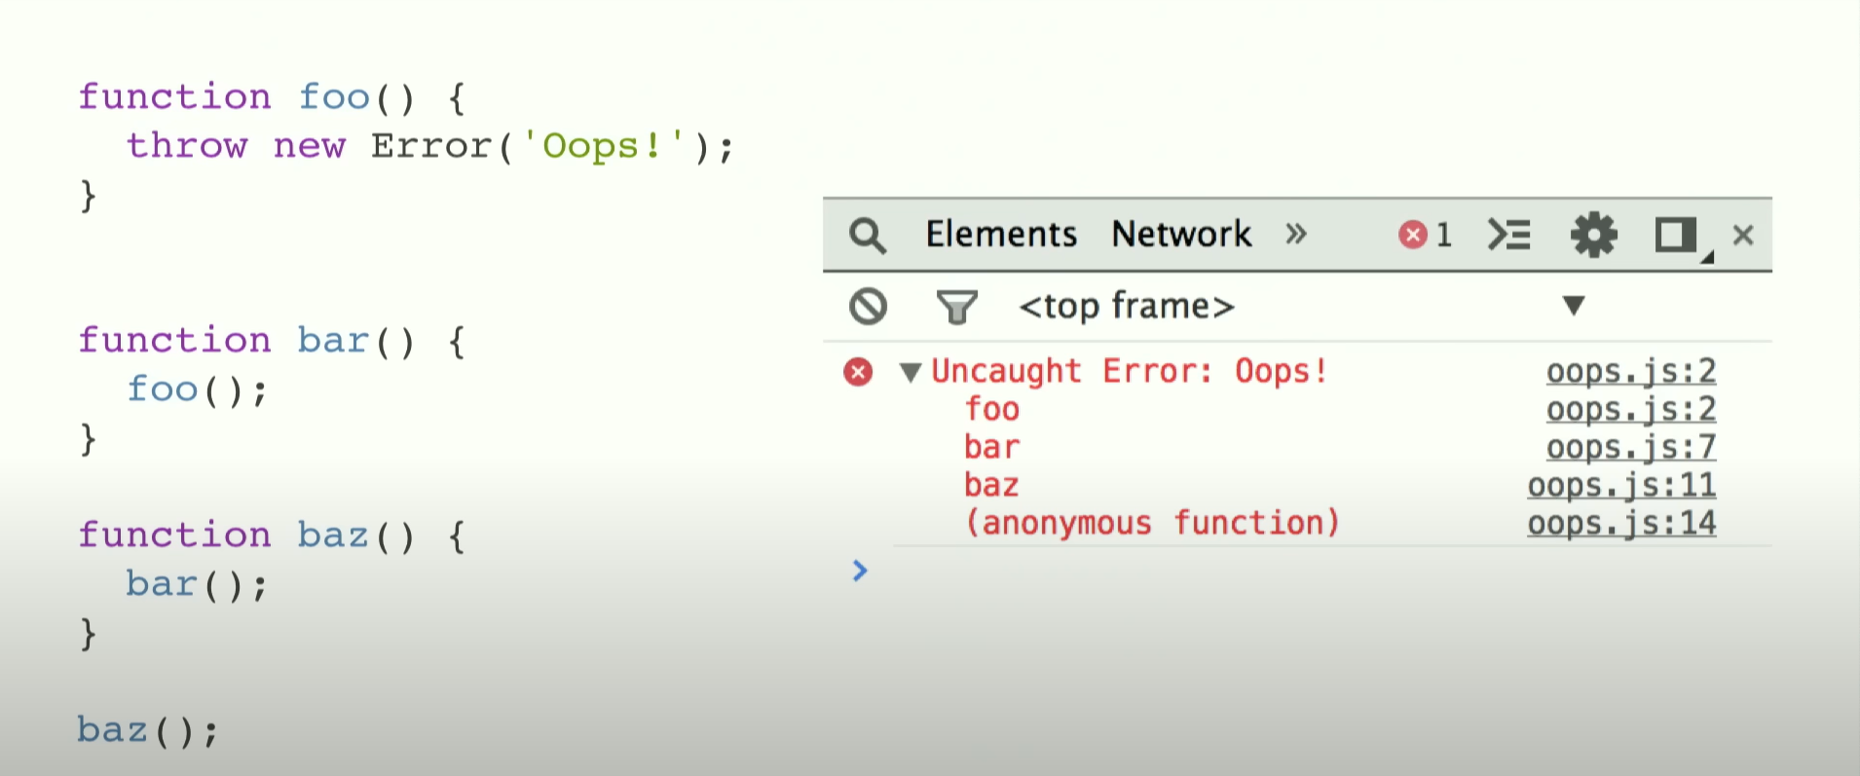
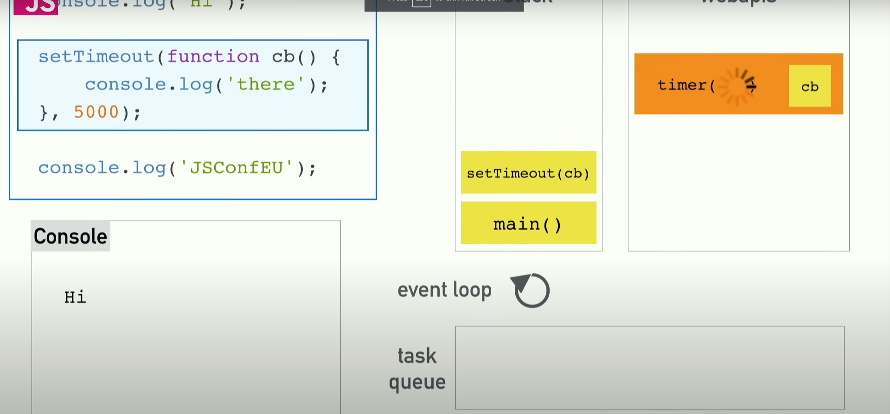
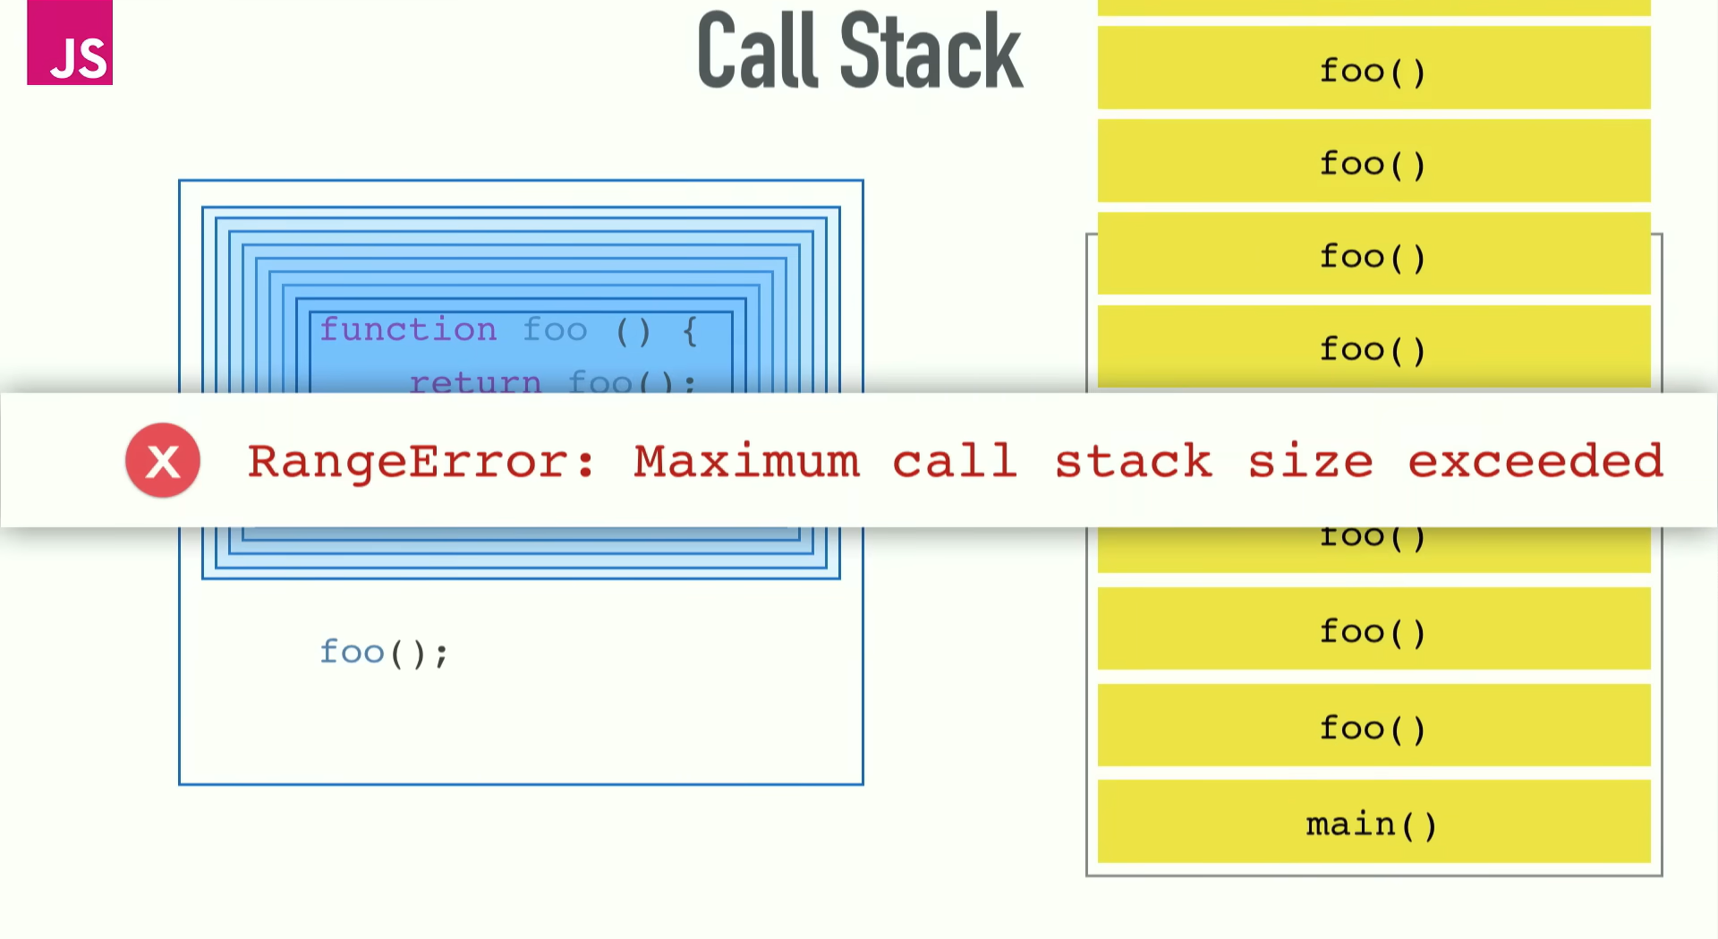
Call Stack

